Slide 1
EFFECTS OF VARIOUS SOCIO-ECONOMIC INDICATORS ON THE SPATIAL DISTRIBUTION OF AVERAGE INCOME IN HELSINKI REGION.
BY: OYEDAYO OYELOWO
STUDENT NUMBER : 014717208

Slide 2
Variable Names:
HR_KTU - Average income of inhabitants, 2014 (HR). --------- RESPONSE VARIABLE
HE_KIKA: Average age of inhabitants, 2015 (HE) ------------- PREDICTORS
HR_OVY: Accumulated purchasing power of inhabitants, 2014 (HR)
KO_KOUL: With education, total, 2014 (KO)
PT_TYOTT: Unemployed, 2014 (PT)
TP_PALV_GU : Services, 2014 (TP)
TP_O_JULK : Public administration and defence; compulsory social security, 2014 (TP)
KO_YL_KORK : Academic degree - Higher level university degree, 2014 (KO)
KO_AMMAT : Vocational diploma, 2014 (KO)
HE_MIEHET : Males, 2015 (HE)
KO_PERUS: Basic level studies, 2014 (KO)

Slide 3

Research Questions
Does Average income vary spatially in Helsinki region?
If so, how much does it vary?
What are the socioeconomic variables affecting average income in the region.
How do their effects vary across the region?

Slide 4
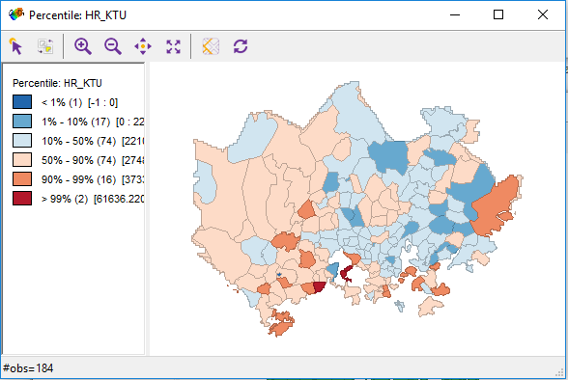
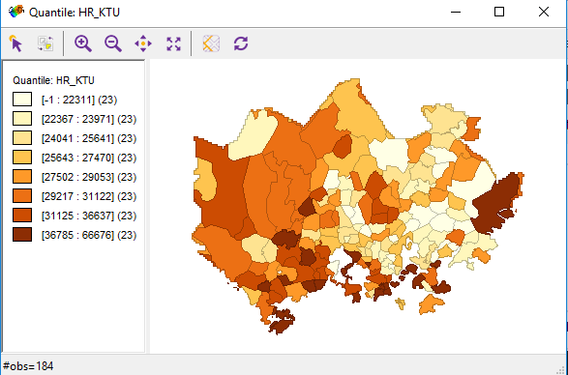
Average Income of Inhabitants, 2014

Slide 5
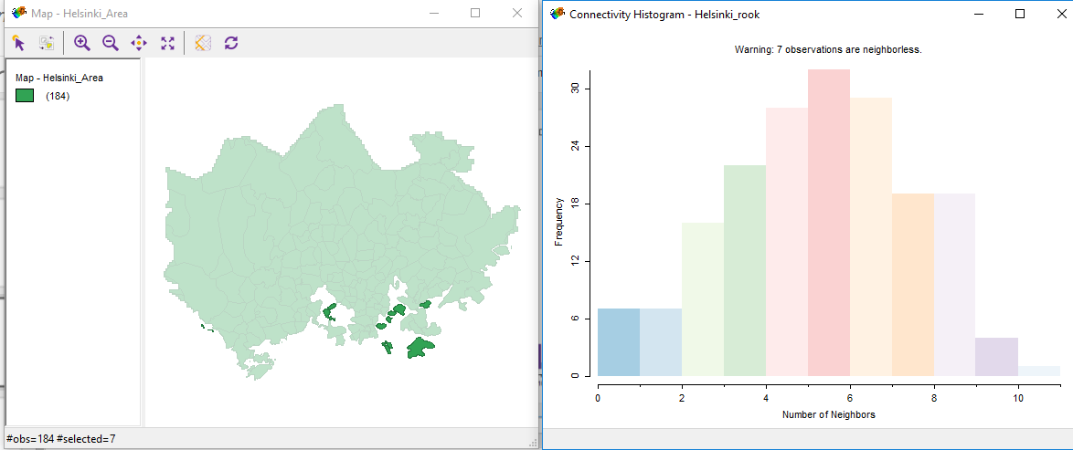
Queen Neighbourhood

Slide 6
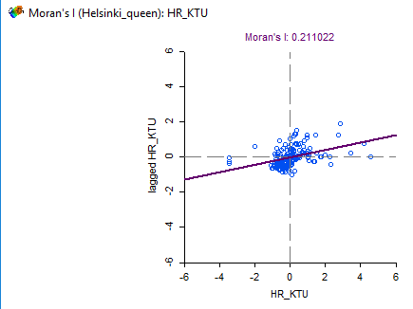
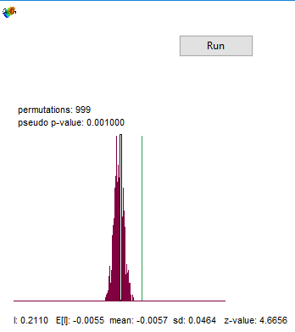
The Spatial Autocorrelation: Global Moran’s I

Slide 7
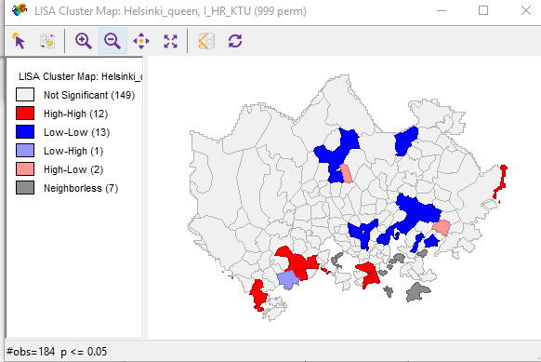
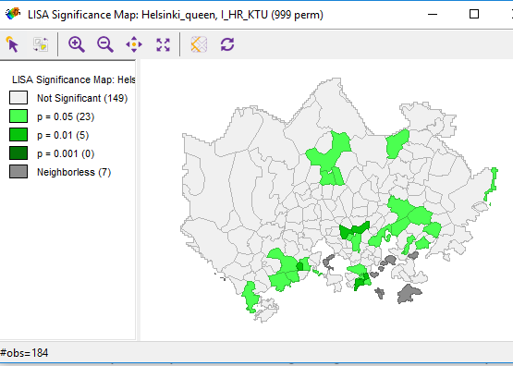
Spatial Autocorrelation

Slide 8
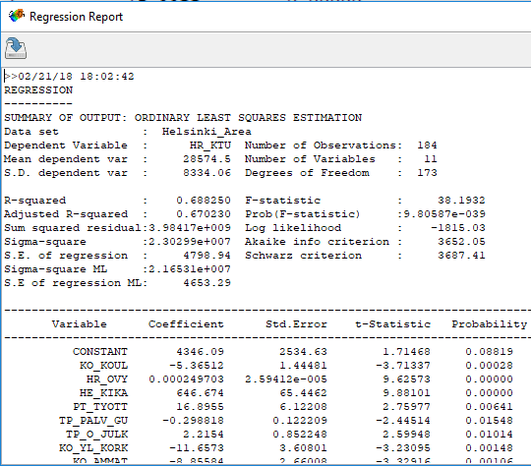

Slide 9
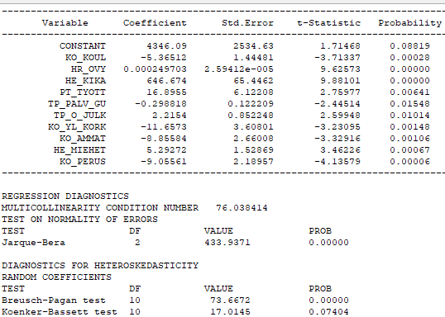
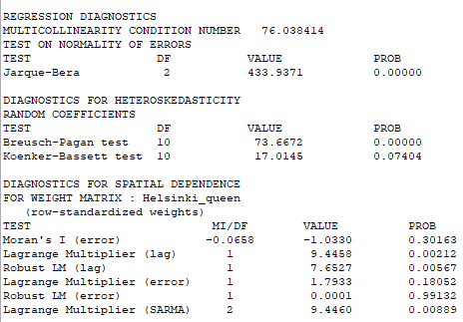
Regression Report

Slide 10
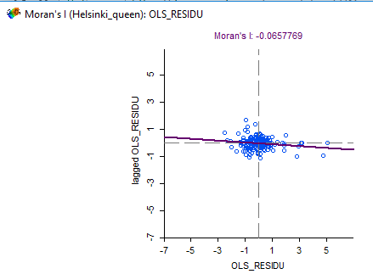
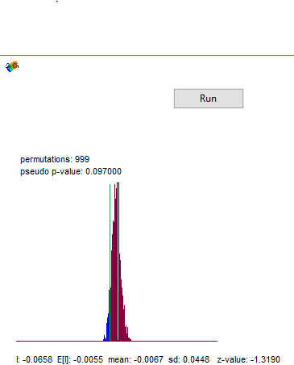
Spatial Autocorrelation of error

Slide 11
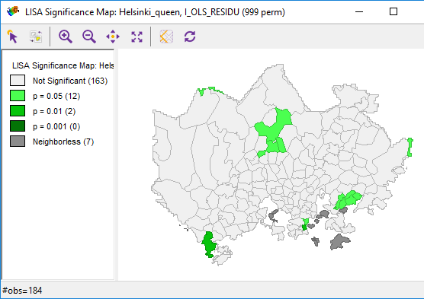
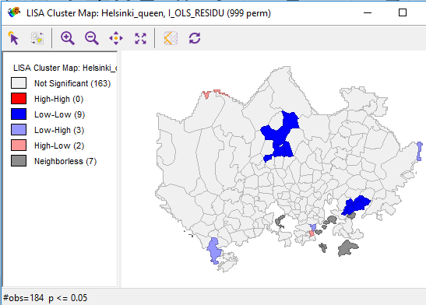
Cluster of the Residuals

Slide 12
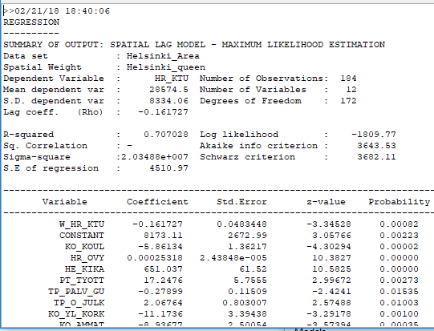
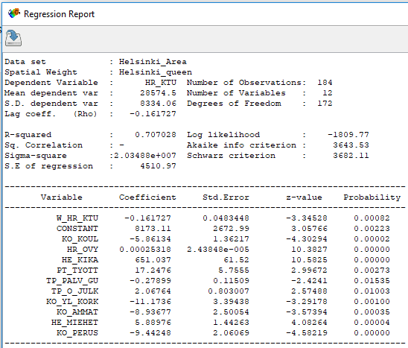
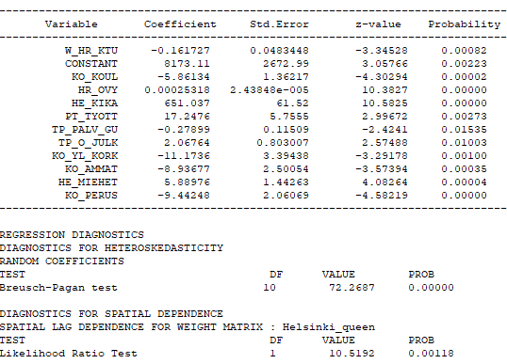
Report: Spatial Lag Model

Slide 13
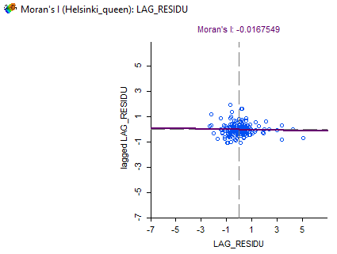
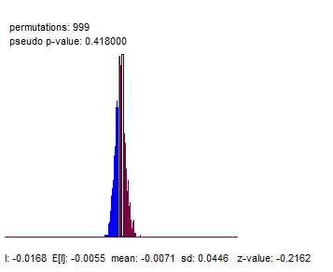
Spatial Lag Residual

Slide 14
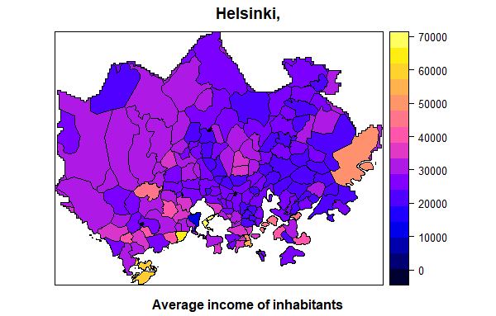
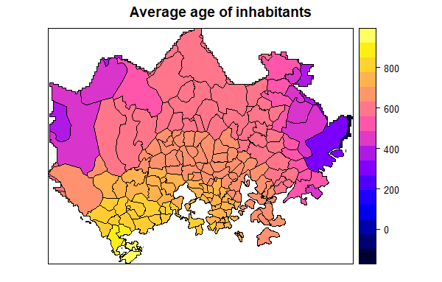
Geographically Weighted Regression

Slide 15
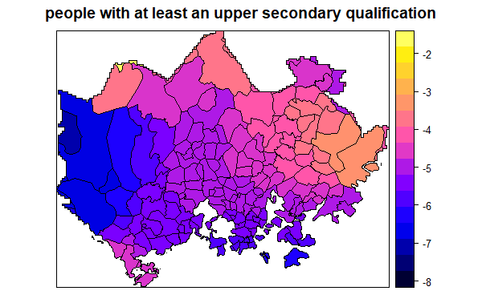
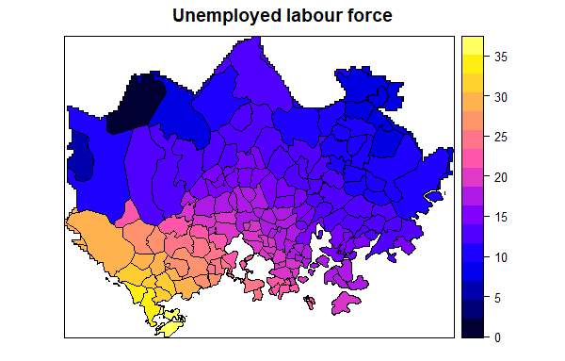
Geographically Weighted Regression

Slide 16
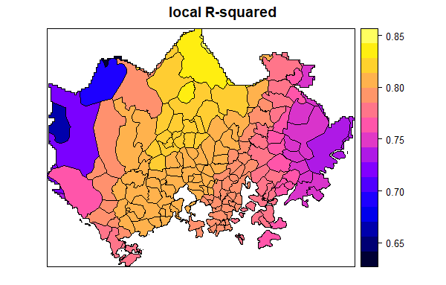
Geographically Weighted Regression

Slide 17
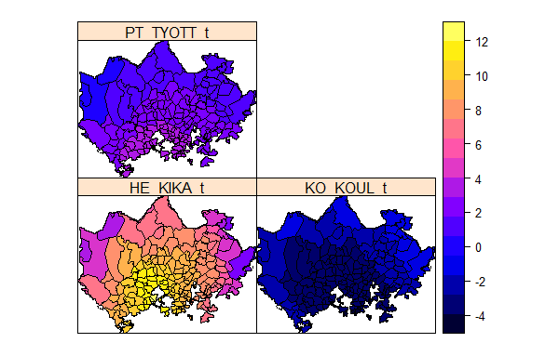
Geographically Weighted Regression

Slide 18
Conclusion:
Coefficient of determination : 70%
Income is generally higher in the west than the east..
Effects of education, age and unemployment on spatial distribution of average income, are highest at the centre compared to the outer regions.
Average age and Unemployed labour force have more impacts on average income in the southwestern area
Education has more impact in the northeastern part.

Slide 19
KITTOS!!!

